Slide 1
Review: Class Inheritance
Inheritance is the passing on of characteristics from one entity to another
The child class inherits all characteristics of the parent class.
The child class inherits methods and attributes from the parent class
A parent class never does more than a child class

Slide 2
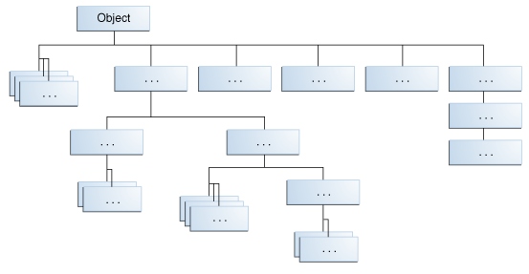
Parent of all classes: Object
ALL Java classes inherit from the Java API class Object
It is located in the java.lang package
Image source: The Java Tutorials. Oracle (2005). Inheritance > Learning the Java Language. https://docs.oracle.com/javase/tutorial/java/IandI/subclasses.html

Slide 3
Classes you write inherit from Object
When you create a class called Customer, it has Object as a superclass
The Object class defines and implements behavior common to all classes e.g.
public String toString()
returns a String representation of the object
when you write a toString() method you are overriding the method in Object
boolean equals(Object obj)
returns true if the object is equal to obj, false otherwise

Slide 4
Terminology
Super Class - Object
Parent
Base
Sub Class - Customer
Child
Derived
Generalised
Specialised
Inheritance creates an “is a” relationship between 2 classes

Slide 5
Types of Classes
Classes can be Concrete OR Abstract
All classes you have written so far have been Concrete
This means you can create objects using your class definition
Example:
public class Customer
{
public Customer(int id, String name) {}
}
Customer customer = new Customer(123, “David”);

Slide 6
Concrete Class
Concrete Class
Can be instantiated (create objects by calling the constructor)
Can be sub classed (can be a parent)
Contains only implemented methods (methods that have a body containing the code to implement the method)
Can contain changeable attributes
e.g. private int id;
A concrete class is a standard class:
So far, we have only looked at concrete classes.

Slide 7
Abstract Class
Abstract Class
May contain abstract methods (method declarations without implementation = no method body).
Cannot be instantiated (can’t create objects for this class type)
May contain some implemented methods.
May contain changeable attributes
Can be sub-classed (can be a parent class)
If a class contains an abstract method the class must be declared abstract
If an abstract class only contains abstract methods it should be declared as an interface (more later)

Slide 8
Abstract Classes
What is different about abstract classes?
The class declaration has the keyword abstract
You CANNOT create objects using an abstract class
Do abstract class have to have abstract methods?
NO
An abstract class is created purely for inheritance, to be a super class

